Slide 1

Motion planning and control of EduMIP among obstacles
Presented by
Han Shi
Site Hu

Slide 2
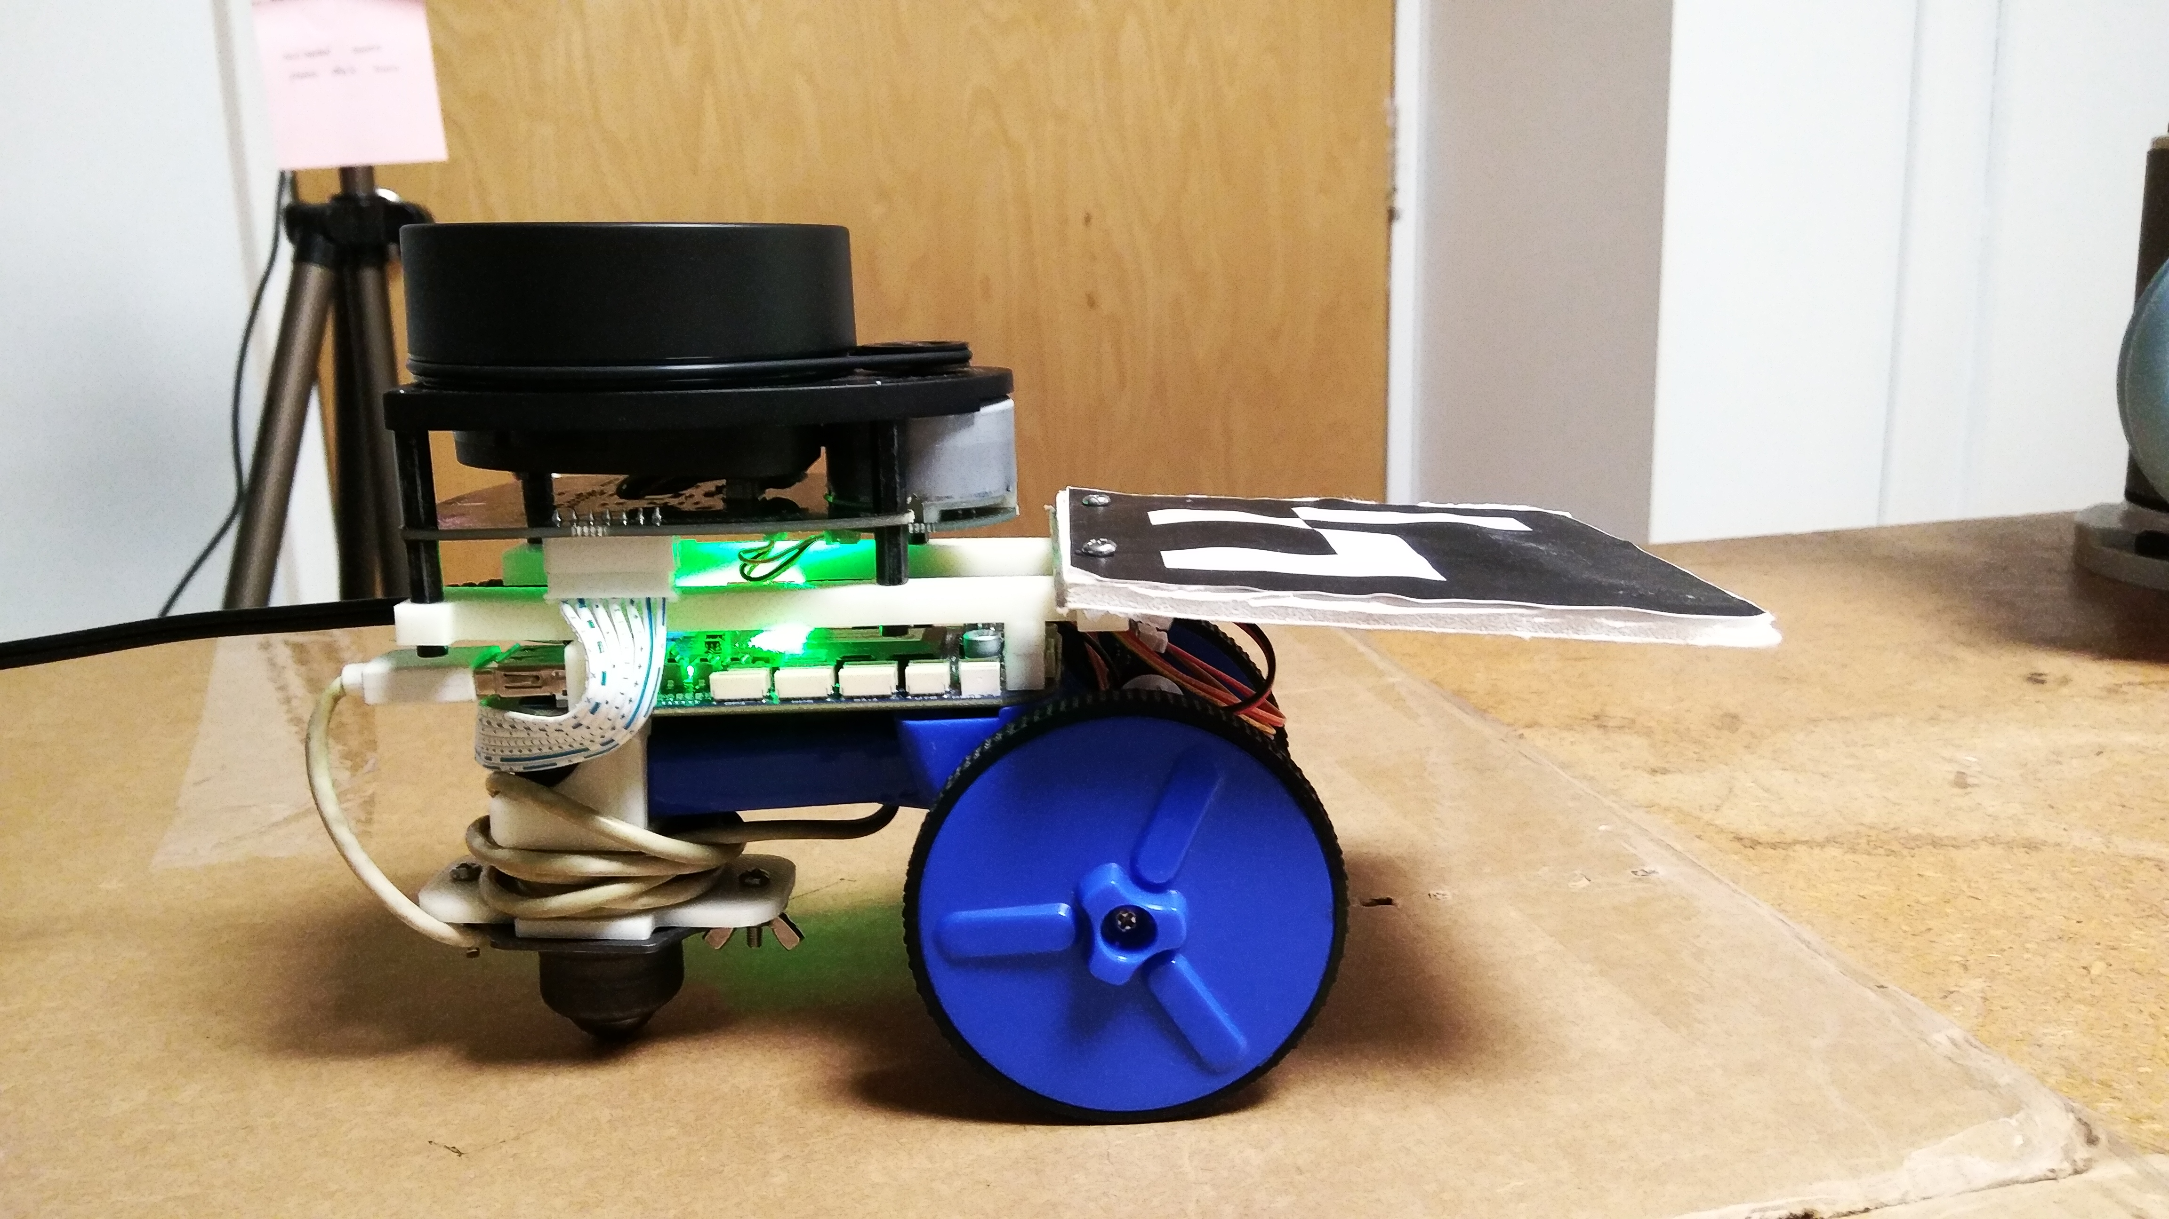
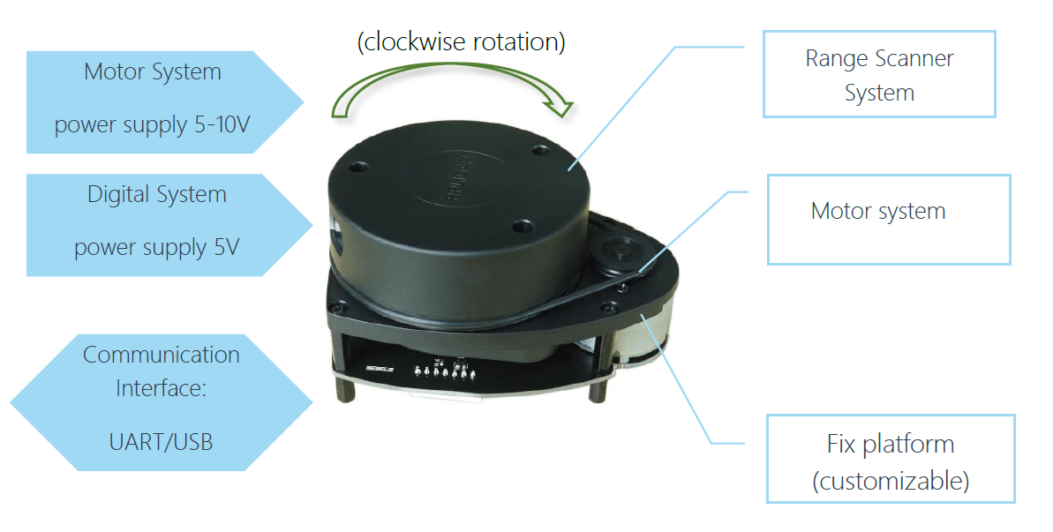
Introduction
EduMIP is a self-balancing robot (see Fig.1). It can be treated as an
unicycle
Goal: develop a motion planning algorithm which computes a desired trajectory to a given desired goal region.
The map used here is generated by Simultaneous Localization and Mapping (SLAM) using a Laser sensor(see Fig.2).
Figure 1: an EduMIP robot with BeagleBone Blue
Figure 2: RPLIDAR A1 System Composition

Slide 3
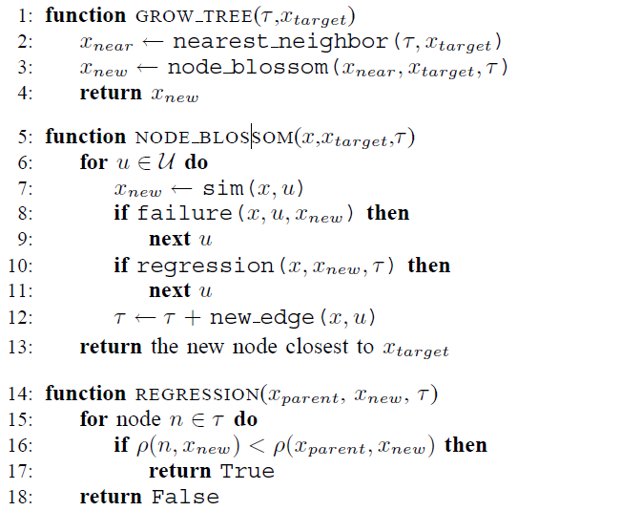
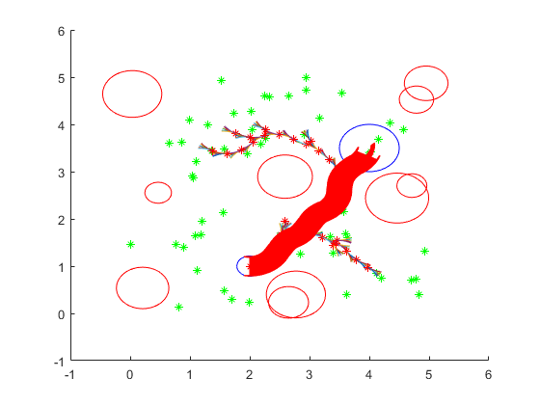
Algorithm – RRT Blossom[1]
RRT blossom is a new variation of the RRT planner which demonstrates good performance on both loosely constrained and highly-constrained environments.
This algorithm handles unsuccessful expansions efficiently, by adding a regression function to make sure that they are never re-attempted.
Figure 3: pseudocode for RRT-blossom
Figure 4: RRT-blossom result
[1]. M. Kalisiak and M. van de Panne, "RRT-blossom: RRT with a local flood-fill behavior," Proceedings 2006 IEEE International Conference on Robotics and Automation, 2006. ICRA 2006., Orlando, FL, 2006, pp. 1237-1242.

Slide 4
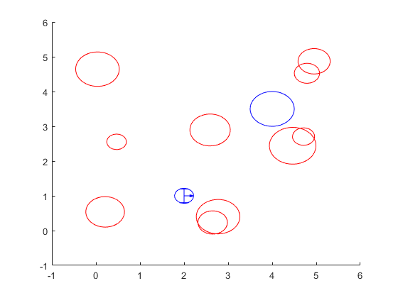
Functions
Existing library : Librobotics[2]
Librobotics is a small but useful library of MATLAB functions frequently used in robotics for plotting. It offers functions to plot different robots, transforms, reference frames, scalable text, error ellipses, or compound operations. We use this to draw the robot and obstacles.
Figure 5: robot and obstacles drawn by Librobotics
[2]. http://srl.informatik.uni-freiburg.de/downloads

Slide 5
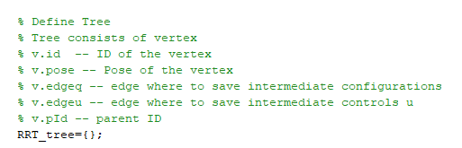
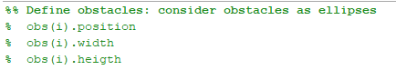
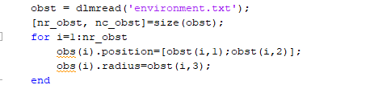
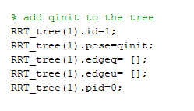
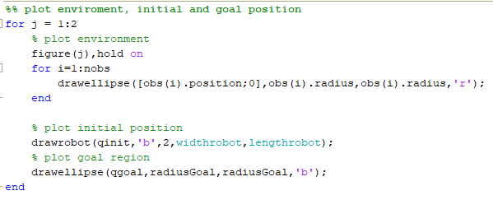
Functions
Define tree and add initial point to the tree
Define obstacles, plot environment and robot
Figure 6: define tree and add initial point
Figure 7: define obstacles

Slide 6
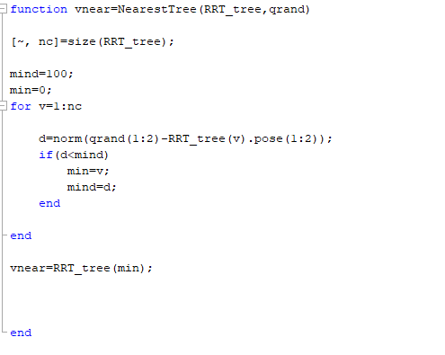
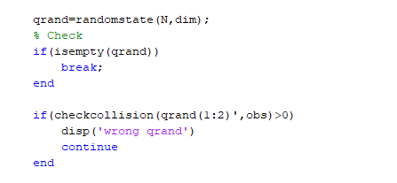
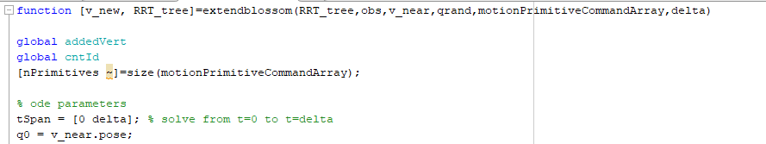
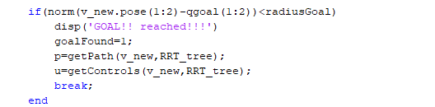
Functions
RRT procedure
Generate Random Configuration and check for collision
Find Nearest Vertex
Extend the tree
If Goal return path
Figure ８: RRT procedure

Slide 7
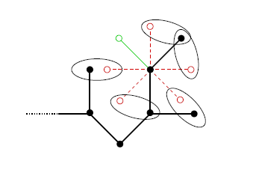
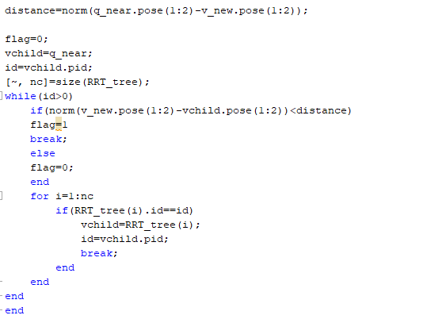
Functions
Regression
The left figure shows the possible expansions for a particular node; all the red expansions (dashed) are regressing since a foreign node is closer than the parent (indicated with loops). Only the single edge in green is suitable for instantiation.
Figure 9: regression
credit: reference[1]

Slide 8
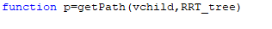

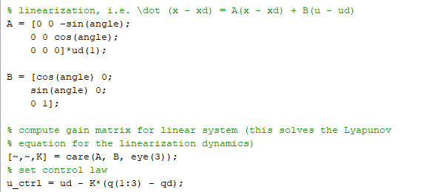
Functions
Trajectory Tracking
Get desired path and controls from the tree
Use feedback linearization to find the controls

Slide 9
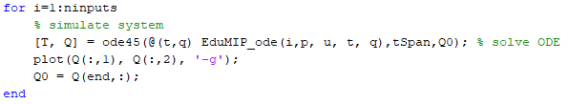
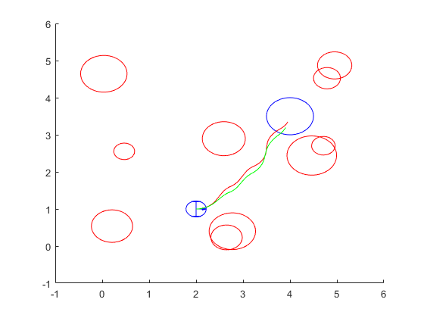
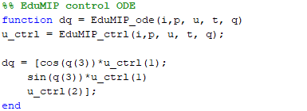
Functions
Trajectory Tracking
Solve the ODE to get actual path
Figure 10: Trajectory tracking

Slide 10
Results
Figure 10: result

Slide 11

Thank You
for
Listening!

